Slide 1
API Management

Slide 2
Appendix
What is API?
Structure of API in Rails
Creating APIs in Rails
Calling APIs in Rails

Slide 3
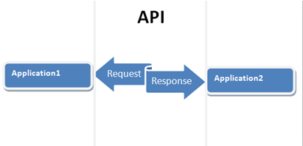
What is API?
An application programming interface (API) is a particular set of rules ('code') and specifications that software programs can follow to communicate with each other.
It serves as an interface between different software programs and facilitates their interaction, similar to the way the user interface facilitates interaction between humans and computers.

Slide 4
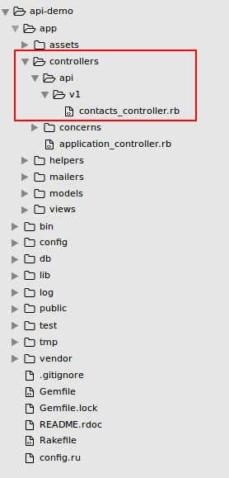
Structure of API

Slide 5
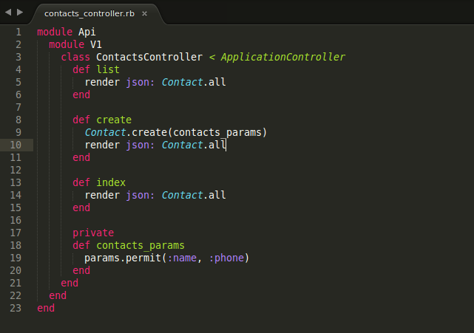
Creating an API

Slide 6
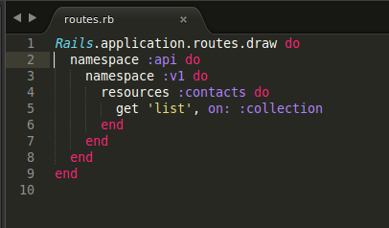
Adding routes

Slide 7
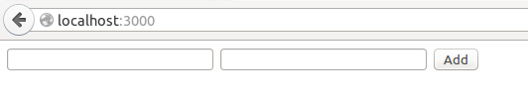
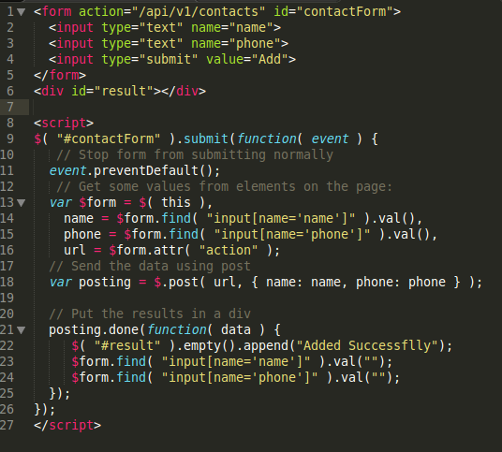
Calling an API

Slide 8
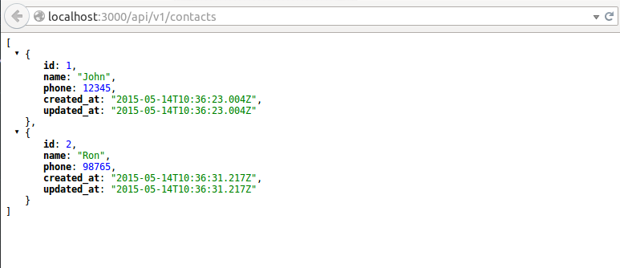
Calling an API

Slide 9

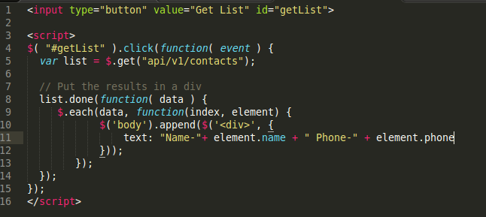
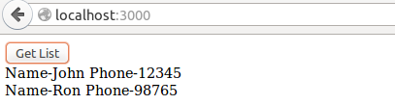
Calling an API

Slide 10


Thank You !!
It is time for questions !!

